Slide 1
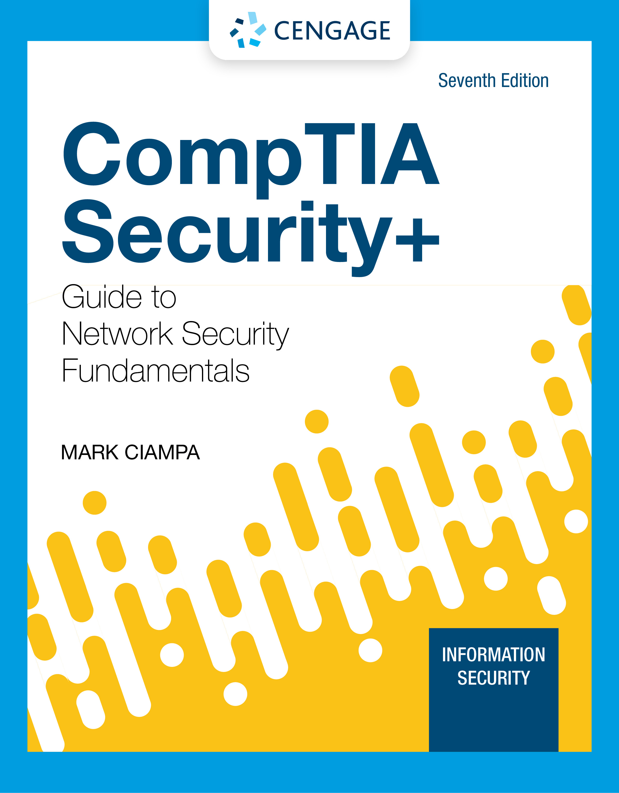
Module 7: Public Key Infrastructure and Cryptographic Protocols
CompTIA Security+ Guide
to Network Security Fundamentals, 7th Edition

Slide 2
Module Objectives
By the end of this module, you should be able to:
1. Define digital certificates
2. Describe the components of Public Key Infrastructure (PKI)
3. Describe the different cryptographic protocols
4. Explain how to implement cryptography

Slide 3
Digital Certificates
Digital certificates is a common application of cryptography
Using digital certificates involves
Understanding their purpose
Knowing how they are managed
Determining which type of digital certificate is appropriate for different situations

Slide 4
Defining Digital Certificates (1 of 2)
A digital signature is used to prove a document originated from a valid sender
Weakness of using digital signatures:
It can only prove that the private key of the sender was used to encrypt the digital signature
An imposter could post a public key under a sender’s name
Trusted third party
Used to help solve the problem of verifying identity
Verifies the owner and that the public key belongs to that owner
A digital certificate is a technology used to associate a user’s identity to a public key that has been “digitally signed” by a trusted third party

Slide 5
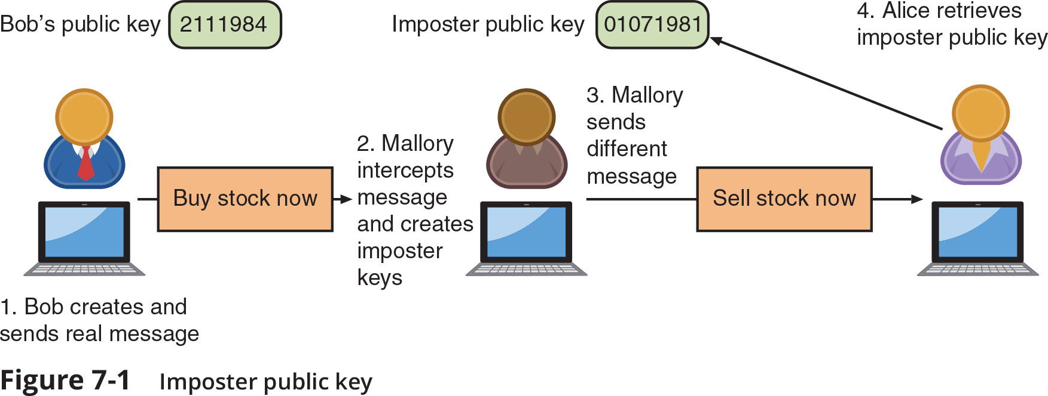
Defining Digital Certificates (2 of 2)
Figure 7-1 Imposter public key

Slide 6
Managing Digital Certificates (1 of 6)
Several entities and technologies are used to manage digital certificates:
Certificate authorities (CAs)
Tools for managing certificates
Certificate Authorities
If a user wants a digital certificate:
After generating a public and private key, the user must complete a request with information such as name, address, email address, known as a Certificate Signing Request (CSR)
User electronically signs the CSR and sends it to an intermediate CA
An intermediate CA processes the CSR and verifies the authenticity of the user

Slide 7
Managing Digital Certificates (2 of 6)
Certificate Authorities (continued)
Intermediate CAs are subordinate entities designed to handle specific CA tasks such as:
Processing certificate requests
Verifying the identity of the individual
The person requesting a digital certificate can be authenticated by:
Email, documents, in person
A common method to ensure security and integrity of a root CA is to keep it in an offline state from the network (offline CA)
It is only brought online (online CA) when needed for specific and infrequent tasks

Slide 8
Managing Digital Certificates (3 of 6)
Certificate Management
Certificate Repository (CR) is a publicly accessible centralized directory of digital certificates
It can be used to view certificate status
The directory can be managed locally by setting it up as a storage area connected to the CA server
Certificate Revocation
Reasons a certificate would be revoked
Certificate is no longer used
Details of the certificate have changed, such as user’s address
Private key has been lost or exposed (or suspected lost or exposed)
A Certificate Revocation List (CRL) is a list of digital certificates that have been revoked

Slide 9
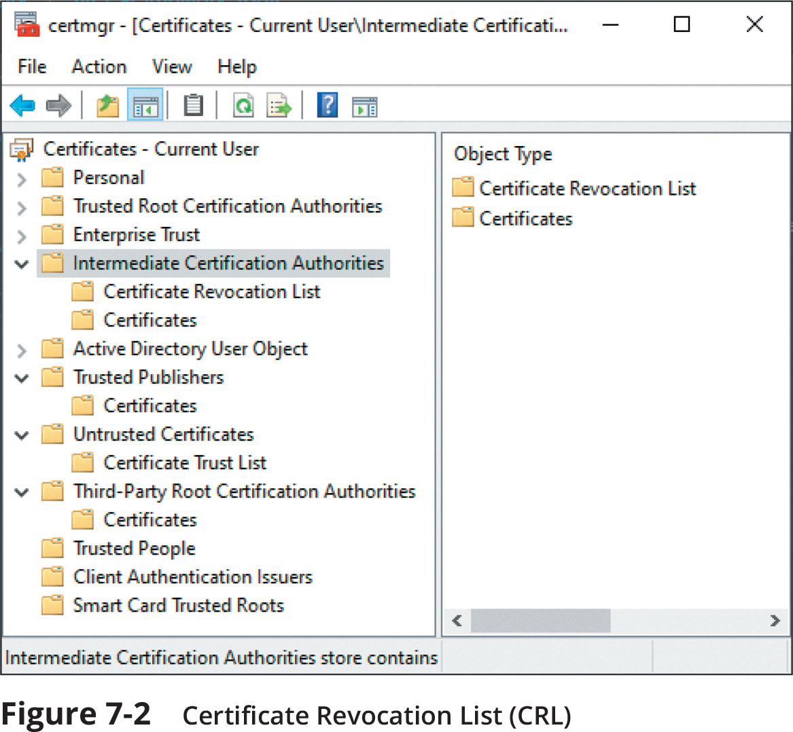
Managing Digital Certificates (4 of 6)
Figure 7-2 Certificate Revocation List (CRL)

Slide 10
Managing Digital Certificates (5 of 6)
Certificate Management (continued)
Online Certificate Status Protocol (OCSP) performs a real-time lookup of a certificate’s status
OCSP is called a request-response protocol
The browser sends the certificate’s information to a trusted entity known as an OCSP Responder
The OCSP Responder provides immediate revocation information on that certificate
OCSP stapling
A variation of OCSP where web servers send queries to the OCSP Responder server at regular intervals to receive a signed time-stamped response

Slide 11
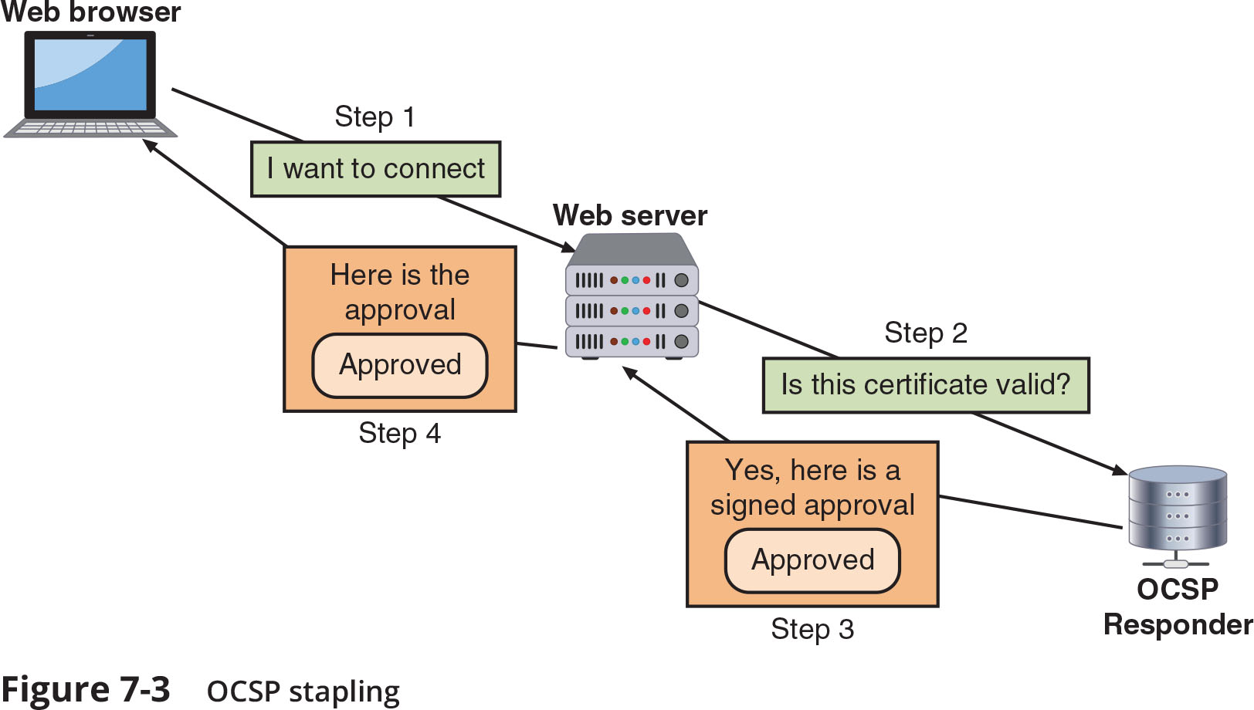
Managing Digital Certificates (6 of 6)
Figure 7-3 OCSP stapling

Slide 12
Types of Digital Certificates (1 of 6)
The most common categories of digital certificates are:
Root certificates
Domain certificates
Hardware and software certificates
Root Digital Certificates
The process of verifying a digital certificate is genuine depends upon certificate chaining
Links several certificates together to establish trust between all the certificates involved
The beginning point of the chain is known as a root digital certificate and is created and verified by a CA
They are self-signed and do not depend upon any higher-level authority
Endpoint of the chain is the user digital certificate itself

Slide 13
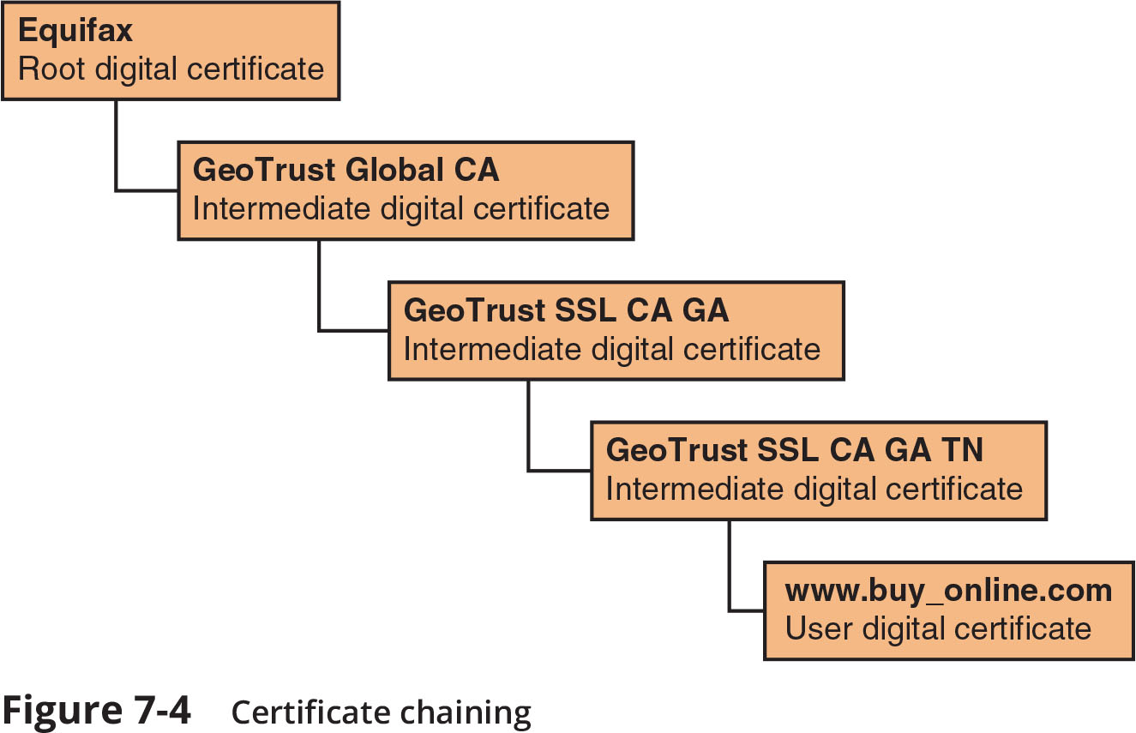
Types of Digital Certificates (2 of 6)
Figure 7-4 Certificate chaining

Slide 14
Types of Digital Certificates (3 of 6)
Domain Digital Certificates
Most digital certificates are web server digital certificates issued from a web server to a client
Web server digital certificates perform two primary functions:
Ensure the authenticity of the web server to the client
Ensure the authenticity of the cryptographic connection to the web server
There are several types of domain digital certificates:
Domain validation digital certificates
Extended validation (EV) digital certificates
Wildcard digital certificates
Subject alternative name (SAN) digital certificates

Slide 15
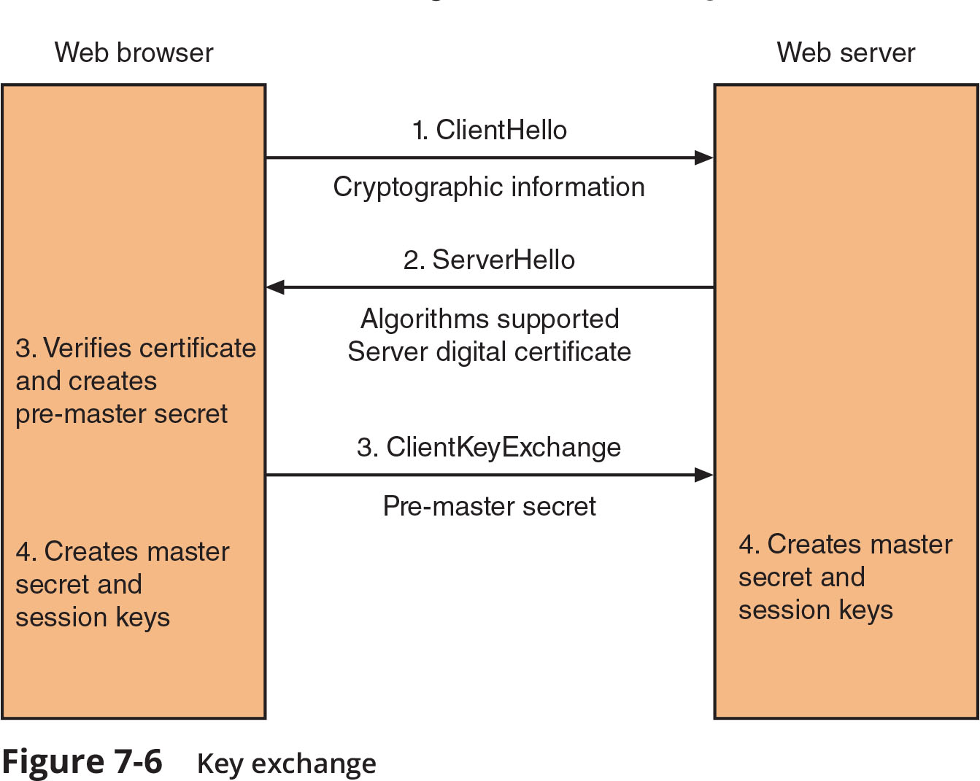
Types of Digital Certificates (4 of 6)
Figure 7-6 Key exchange

Slide 16
Types of Digital Certificates (5 of 6)
Hardware and Software Digital Certificates
More specific digital certificates relate to hardware and software:
Machine/computer digital certificate
Code signing digital certificate
Email digital certificate
Digital Certificate Attributes and Formats
The standard format for digital certificates is X.509
All x.509 certificates follow the standard ITU-T x.690, which specifies one of three encoding formats:
Basic Encoding Rules (BER)
Canonical Encoding Rules (CER)
Distinguished Encoding Rules (DER)

Slide 17
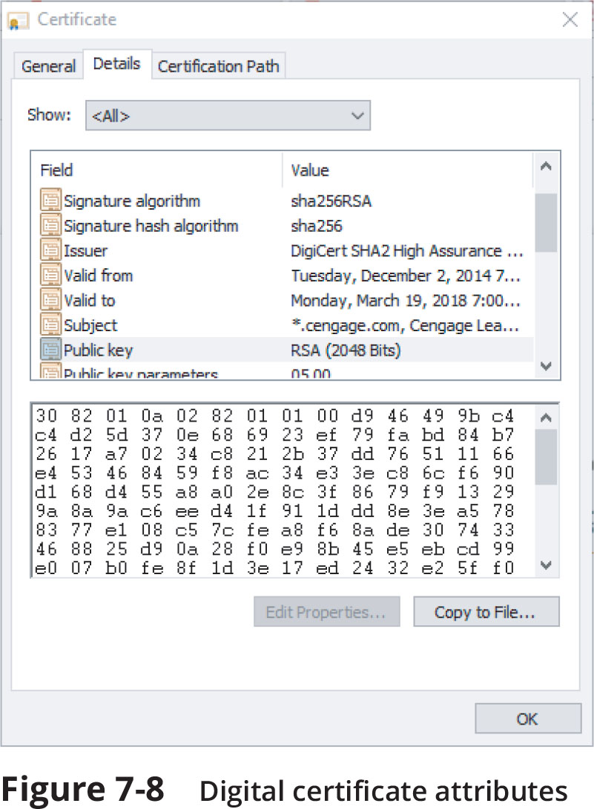
Types of Digital Certificates (6 of 6)
Figure 7-8 Digital certificate attributes

Slide 18
Knowledge Check Activity 1
Which of the following is the beginning point of a certificate chain?
a. User certificate
b. Intermediate certificate
c. Root certificate
d. Top-level certificate

Slide 19
Knowledge Check Activity 1: Answer
Which of the following is the beginning point of a certificate chain?
Answer: c. Root certificate
The beginning point of a certificate chain is the root certificate and they do not depend on a higher-level authority.

Slide 20
Public Key Infrastructure (PKI)
PKI is one of the most important management tools for the use of:
Digital certificates:
Asymmetric cryptography
It is important to understand PKI:
Know PKI trust models
How it is managed
Features of key management

Slide 21
What is Public Key Infrastructure (PKI)?
There is a need for a consistent means to manage digital certificates
Public key infrastructure (PKI) is a framework for all entities involved in digital certificates
Certificate management actions facilitated by PKI
Create
Store
Distribute
Revoke

Slide 22
Trust Models (1 of 3)
Trust is defined as confidence in or reliance on another person or entity
A trust model refers to the type of trust relationship that can exist between individuals and entities
Direct trust is a type of trust model where one person knows the other person
Third-party trust refers to a situation where two individuals trust each other because each trusts a third party
The web of trust model is based on direct trust
Each user signs a digital certificate then exchanges certificates with all other users
Three PKI trust models use a CA:
The hierarchical trust model, the distributed trust model, and the bridge trust model

Slide 23
Trust Models (2 of 3)
Hierarchical Trust Model
The hierarchical trust model assigns a single hierarchy with one master CA called root
The root signs all digital certificate authorities with a single key
This model can be used in an organization where one CA is responsible for only that organization’s digital certificates
Hierarchical trust model limitations:
A single CA private key may be compromised rendering all certificates worthless
Having a single CA who must verify and sign all digital certificates may create a significant backlog
Distributed Trust Model
The distributed trust model has multiple CAs that sign digital certificates
Eliminates limitations of hierarchical trust model

Slide 24
Trust Models (3 of 3)
Bridge Trust Model
The bridge trust model is similar to the distributed trust model
One CA acts as a facilitator to interconnect connect all other CAs
Facilitator CA does not issue digital certificates, instead it acts as hub between hierarchical and distributed trust model
Allows the different models to be linked

Slide 25
Managing PKI (1 of 2)
Certificate Policy (CP)
A certificate policy (CP) is a published set of rules that govern operation of a PKI
The CP provides recommended baseline security requirements for the use and operation of CA, RA, and other PKI components
Certificate Practice Statement (CPS)
A certificate practice statement is a technical document that describes in detail how the CA uses and manages certificates
It also covers how to register for a digital certificate, how to issue them, when to revoke them, procedural controls and key pair management

Slide 26
Managing PKI (2 of 2)
Certificate Life Cycle
Creation
Occurs after user is positively identified
Suspension
May occur when employee on leave of absence
Revocation
Certificate no longer valid
Expiration
Key can no longer be used

Slide 27
Key Management (1 of 2)
Key Storage
Public keys can be stored by embedding them within digital certificates
Private keys can be stored on user’s local system
Software-based storage may expose keys to attackers
Alternative: storing keys in hardware
Smart-cards
Tokens
Key Usage
Multiple pairs of dual keys can be created
One pair is used to encrypt information and the public key backed up in another location
Second pair would be used only for digital signatures and the public key in that pair would never be backed up

Slide 28
Key Management (2 of 2)
Key Handling Procedures
Escrow
Expiration
Renewal
Revocation
Recovery
Suspension
Destruction

Slide 29
Knowledge Check Activity 2
Which of the following is considered a non-secure place where PKI encryption keys may be stored?
a. Smart-card
b. Token
c. In a digital certificate
d. Local system

Slide 30
Knowledge Check Activity 2: Answer
Which of the following is considered a non-secure place where PKI encryption keys may be stored?
Answer: d. Local system
Private keys can be stored on a user’s local system but this can leave keys open to attacks due to possible vulnerabilities in the OS. Storing keys in hardware such as tokens and smart-cards is usually a more secure alternative.

Slide 31
Cryptographic Protocols
The most common cryptographic transport algorithms include the following:
Secure Sockets Layer
Transport Layer Security
Secure Shell
Hypertext Transport Protocol Secure
S/MIME
Secure Real-time Transport Protocol
IP Security

Slide 32
Secure Sockets Layer (SSL)
Secure Sockets Layer (SSL) is one of the most common cryptographic protocols
Developed by Netscape in 1994
The design goal was to create an encrypted data path between a client and a server
SSL uses the Advanced Encryption Standard (AES)
SSL version 3.0 is the current version

Slide 33
Transport Layer Security (TLS)
Transport Layer Security (TLS) is a replacement for SSL
Versions starting with v1.1 are significantly more secure than SSL v3.0
Current version is TLS v1.2
A cipher suite is a named combination of the encryption, authentication, and message authentication code (MAC) algorithms that are used with SSL and TLS

Slide 34
Secure Shell (SSH)
Secure Shell (SSH) is an encrypted alternative to the Telnet protocol used to access remote computers
It is a Linux/UNIX-based command interface and protocol
SSH is a suite of three utilities: slogin, ssh, and scp
Client and server ends of the connection are authenticated using a digital certificate and passwords are encrypted
SSH can be used as a tool for secure network backups

Slide 35
Hypertext Transport Protocol Secure (HTTPS)
A common use of TLS and SSL is to secure Hypertext Transport Protocol (HTTP) communications between a browser and Web server
The secure version is actually “plain” HTTP sent over SSL or TLS and is called Hypertext Transport Protocol Secure (HTTPS)
HTTPS uses port 443 instead of HTTP’s port 80
Users must enter URLs with https://

Slide 36
Secure/Multipurpose Internet Mail Extensions (S/MIME)
Secure/Multipurpose Internet Mail Extensions (S/MIME) is a protocol for securing email messages
MIME is a standard for how an electronic message will be organized, so S/MIME describes how encryption information and a digital certificate can be included as part of the message body
S/MIME allows users to send encrypted messages that are also digitally signed

Slide 37
Secure Real-time Transport Protocol (SRTP)
Secure Real-time Transport Protocol (SRTP) is a secure extension protecting transmission using the Real-time Transport Protocol (RTP)
SRTP provides protection for Voice over IP (VoIP) communications
Adds security features such as message authentication and confidentiality for VoIP Communications

Slide 38
IP Security (IPsec)
IPsec is a protocol suite for securing Internet Protocol (IP) communications
IPsec is considered to be a transparent security protocol
Transparent to applications, users, and software
IPsec provides three areas of protection that correspond to three IPsec protocols:
Authentication
Confidentiality
Key management
IPsec supports two encryption modes:
Transport mode encrypts only the data portion of each packet and leaves the header unencrypted
Tunnel mode encrypts both the header and the data portion

Slide 39
Weaknesses of Cryptographic Protocols
Due to the complexity of networking, cryptographic protocols are notoriously difficult to design
While the mathematics and related security of basic cryptographic algorithms have been extensively studied, the same cannot be said of cryptographic protocols
Older cryptographic protocols were designed by networking experts and not by cryptographic protocol experts
The associated security proofs to guarantee the correctness of cryptographic protocols are much more complicated than those for cryptographic algorithms

Slide 40
Knowledge Check Activity 3
Which encryption protocol is used for securing email messages?
a. S/MIME
b. SRTP
c. HTTPS
d. TLS

Slide 41
Knowledge Check Activity 3: Answer
Which encryption protocol is used for securing email messages?
Answer: a. S/MIME
Secure/Multipurpose Internet Mail Extensions (S/MIME) is used to secure email messages. SRTP provides VOIP protection, HTTPS is used, along with TLS, to secure communication between a Web browser and Web server.

Slide 42
Implementing Cryptography
Cryptography that is improperly applied can lead to vulnerabilities
It is essential to understand the different options that relate to cryptography
Implementing cryptography includes understanding:
Key strength
Secret algorithms
Block cipher modes of operation
Cryptographic service providers
The use of algorithm input values

Slide 43
Key Strength
A cryptographic key is a value that serves as input to an algorithm
It transforms plaintext into ciphertext (and vice versa for decryption)
Three primary characteristics that determine the resiliency of the key to attacks (called key strength)
Randomness
Length of the key
Cryptoperiod – length of time for which a key is authorized for use

Slide 44
Secret Algorithms
Keys must be kept secret, does the same apply to algorithms?
Would a secret algorithm enhance security in the same way as keeping a key or password secret?
No
For a cryptography to be useful it needs to be widespread:
A military force that uses cryptography must allow many users to know of its existence to use it

Slide 45
Block Cipher Modes of Operation
A block cipher manipulates an entire block of plaintext at one time
The plaintext is divided into separate blocks of specific lengths
Each block is encrypted independently
A block cipher mode of operation specifies how block ciphers should handle these blocks
Most common modes:
Electronic Code Book (ECB)
Cipher Block Chaining (CBC)
Counter (CTR)
Galois/Counter (GCM)

Slide 46
Crypto Service Providers
A crypto service provider allows an application to implement an encryption algorithm for execution
Crypto service providers typically:
Implement cryptographic algorithms
Generate keys
Provide key storage
Authenticate users by calling various crypto modules to perform specific tasks
Crypto service providers can be implemented in:
Software, hardware, or both

Slide 47
Knowledge Check Activity 4
Which of the following is NOT a primary characteristic of key strength?
a. Randomness
b. Uniqueness
c. Key length
d. Cryptoperiod

Slide 48
Knowledge Check Activity 4: Answer
Which of the following is NOT a primary characteristic of key strength?
Answer: b. Uniqueness
The three primary characteristics that determine the resiliency of the key to attacks, or key strength, are: randomness, length of key, and cryptoperiod.

Slide 49
Self-Assessment
Do case projects 7-3 and 7-4 which relate to Certificate Authorities. Then consider the following questions: How important is the CA from which you purchase a digital certificate? What are the ramifications of using a certificate from an unreliable source?

Slide 50
Summary (1 of 2)
A digital certificate is the user’s public key that has been digitally signed by a trusted third party who verifies the owner and that the public key belongs to that owner
A Certificate Repository (CR) is a list of approved digital certificates
The process of verifying that a digital certificate is genuine depends upon certificate chaining, or linking several certificates together to establish trust between all the certificates involved
Domain validation digital certificates verify the identity of the entity that has control over the domain name but indicate nothing regarding the trustworthiness of the individuals behind the site
A public key infrastructure (PKI) is the underlying infrastructure for key management of public keys and digital certificates

Slide 51
Summary (2 of 2)
An organization that uses multiple digital certificates on a regular basis needs to properly manage those digital certificates
Cryptography is commonly used to protect data in transit/motion
Cryptography that is improperly applied can lead to vulnerabilities that will be exploited

